Slide 1
INFORMATION THEORY
Error control.
Hamming code
IITU, ALMATY, 2019

Slide 2
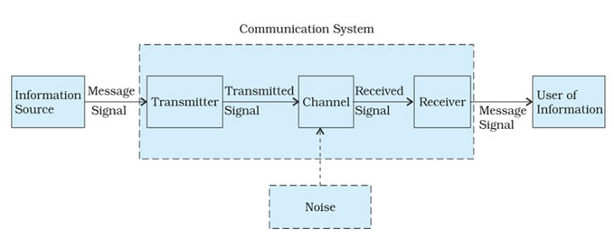
Communication system

Slide 3
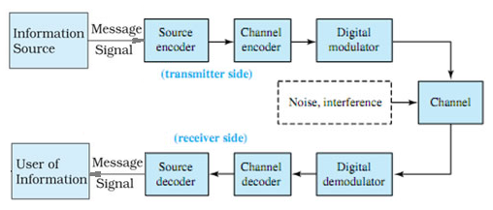
Communication system

Slide 4
Error control
In information theory and coding theory with applications in computer science and telecommunication error control are techniques that enable reliable delivery of digital data over unreliable communication channels.
Types of error control:
Error detection is the detection of errors caused by noise or other impairments during transmission from the transmitter to the receiver.
Error correction is the detection of errors and reconstruction of the original, error-free data.

Slide 5
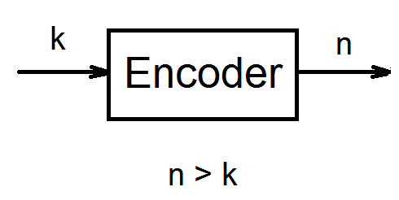
Main idea
The general idea for achieving error detection and correction is to add some redundancy (i.e., some extra data) to a message, which receivers can use to check consistency of the delivered message, and to recover data determined to be corrupted.

Slide 6
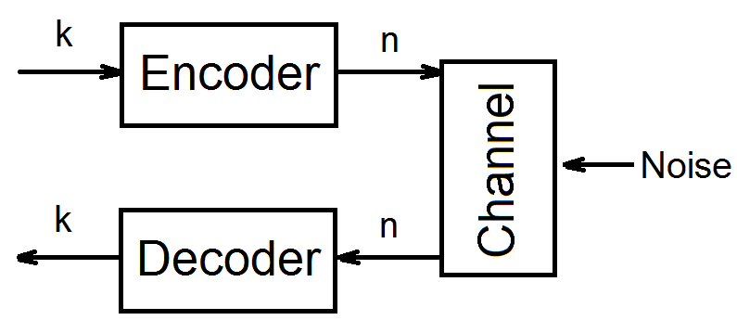
Main idea

Slide 7
Error control
Different techniques of coding:
Block code
Convolutional code

Slide 8
Block codes
k - length of each block before coding
n - length of each block after coding
such codes are denoted (n, k)
as before n > k
code rate:
R=k/n

Slide 9
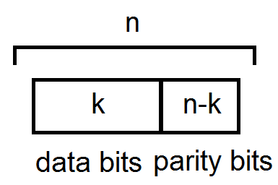
Block codes
Blocks:
Data bits – information
Parity bits – redundant

Slide 10
Example
Parity bit:
0 – if number of “1” in code combination is even
1 – if number of “1” in code combination is odd
Example
101 – code combination before coding
1010 - code combination after coding

Slide 11
Different combinations
Types of code combinations after a channel:
permissible (allowable) combinations – code combination without error(s)
prohibited (not allowable) combinations - code combination with error(s)

Slide 12
Detection or correction?
Hamming distance between two strings of equal length is the number of positions at which the corresponding symbols are different.
In another way, Hamming distance measures the minimum number of substitutions required to change one string into the other, or the minimum number of errors that could have transformed one string into the other.

Slide 13
Hamming distance: examples
"karolin" and "kathrin" is 3.
"karolin" and "kerstin" is 3.
1011101 and 1001001 is 2.
2173896 and 2233796 is 3.
For binary strings a and b the Hamming distance is equal to the number of ones in a XOR b.

Slide 14
Example 1: Hamming distance=1
When d=1 all code combinations are allowable and any mistake will cause the transition to another allowable code combination. Which means that no error can be detected. For example, when n=3, allowable combinations form the following set:
000 | 001 | 010 | 011 | 100 | 101 | 110 | 111

Slide 15
Example 2: Hamming distance=2
With Hamming code distance d=2 there is no one from allowable code words which could transform to another. These are already allowable and not allowable combinations, so errors can be detected, but not corrected. For example, suppose n=3 as before.
allowable | 000 | 011 | 101 | 110
not allowable | 001 | 010 | 100 | 111

Slide 16
Example 3: Hamming distance=3
In this example Hamming distance is enough for not only error detection, but also error correction. Every allowable combination has set of not allowable.
allowable | not allowable
000 | 001 010 100
111 | 011 101 110

Slide 17
Basic formulas
Detect errors of multiplicity r:
dmin >= r+1
Correct errors of multiplicity s:
dmin >= 2s+1
To detect errors of multiplicity r and to correct errors of multiplicity s (general formula):
dmin >= s+r+1

Slide 18
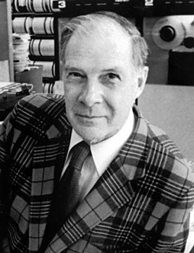
Hamming code
Hamming codes are a family of linear error-correcting codes that generalize the Hamming (7,4) - code invented by Richard Hamming in 1950.
Error detection &
error correction

Slide 19
Main ideas
Hamming was interested in two problems at once:
  increasing the distance as much as possible
  at the same time increasing the code rate as much as possible.
The key to all of his systems was to have the parity bits overlap, such that they managed to check each other as well as the data.

Slide 20
Structure rule of Hamming codes
For each integer r ≥ 2 there is a code with block length n = 2^r−1 and message length k = 2^r−r−1.
(n, k)=(2^r−1, 2^r−r−1)
For example, (7, 4), (15, 11), (31, 26), etc
Parity bits (r) | Total bits (n) | Data bits (k) | Name | Rate
3 | 7 | 4 | Hamming(7,4) | 4/7 ≈ 0.571
4 | 15 | 11 | Hamming(15,11) | 11/15 ≈ 0.733
5 | 31 | 26 | Hamming(31,26) | 26/31 ≈ 0.839

Slide 21
Hamming (7,4) code
In 1950, Hamming introduced the (7,4) Hamming code. It encodes 4 data bits into 7 bits by adding three parity bits.
(i1, i2, i3, i4) -> (i1, i2, i3, i4, r1, r2, r3),
i – data bits and r – parity bits
It can detect and correct single-bit errors – SEC (single-error correcting ).

Slide 22
Encoding Hamming(7,4)
The key thing about Hamming Codes is that any given bit is included in a unique set of parity bits.
r1 = i1 XOR i2 XOR i3
r2 = i2 XOR i3 XOR i4
r3 = i1 XOR i2 XOR i4

Slide 23
Decoding (7,4)
Decoder gets a codeword (i1, i2, i3, i4, r1, r2, r3), where every bit can be an error bit (including data and parity bits).
The pattern of errors, called the error syndrome, identifies the bit in error.
S1 = r1 XOR i1 XOR i2 XOR i3
S2 = r2 XOR i2 XOR i3 XOR i4
S3 = r3 XOR i1 XOR i2 XOR i4
S = (s1, s2, s3) - error syndrome

Slide 24
Decoding (7,4)
Error syndrome | Error bit
000 | No error
001 | r3
010 | r2
011 | i4
100 | r1
101 | i1
110 | i3
111 | i2

Slide 25
Example 1: an error in data bit
Combination before encoding: 1001
Combination after encoding: 1001110
Single random error: i4
Combination with error: 1000110
Decoding syndrome: 011 -> i4
Decoding (error correction): 1001110
After decoding 1001

Slide 26
Example 2: an error in parity bit
Combination before encoding: 1001
Combination after encoding: 1001110
Single random error: r2
Combination with error: 1001100
Decoding syndrome: 010 -> r2
Decoding (error correction): 1001110
After decoding 1001

Slide 27
General algorithm
To compare different approaches consider Hamming(7,4) as example.
However this general algorithm can be used for any length codewords.
In the example:
Input: 4-bit code word x1…x4

Slide 28

Input codeword
Row 1 – number of position in the codeword
Row 2 – bit notation
Row 3 – bit value
(so example codeword is “1001”)

Slide 29
Number of parity bits
In general, the number of parity bits in the codeword is equal to the binary logarithm of the number of bits of the codeword (including parity bits) in rounded up to the nearest integer:
r ≈ log2(n)
In the example, r = log2(7) ≈ 3

Slide 30

Addition of parity bits
Add parity bits r0,r1,r2
Number of positions are integer powers of 2: 0, 1, 2, etc: 2^0, 2^1, 2^2, etc.
Now we have 7-bit word with 4 data bits and 3 parity bits.
Initially parity bits are set to zero.

Slide 31
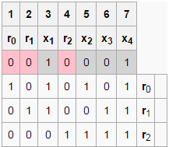
Transformation matrix
Add to table 3 rows (number of parity bits) with a transformation matrix.
Each row is one parity bit (top down), each column is one bit of codeword.

Slide 32
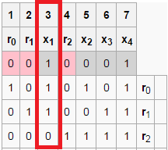

Transformation matrix
Each column of a transformation matrix is a binary number of this column, but bit order is reverse: the least significant bit is on the top line, a senior - at the bottom.
For example, 3rd column is “110” corresponding to the binary representation of the number “3”: 011.

Slide 33
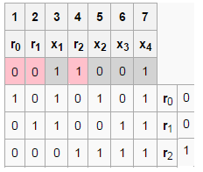

Calculation of parity bits
r0 = (1·0+0·0+1·1+0·0+1·0+0·0+1·1) mod 2 = 2 mod 2 = 0
r1 = (0·0+1·0+1·1+0·0+0·0+1·0+1·1) mod 2 = 2 mod 2 = 0
r2 = 0·0+0·0+0·1+1·0+1·0+1·0+1·1 =1
The resulting control bits inserted into codeword instead of standing there before zeros.
Hamming coding is completed. The resulting code word - 0011001

Slide 34
Decoding
Algorithm of decoding is absolutely identical to encoding algorithm.
Goal of decoding is get a syndrome matrix.
As before the syndrome matrix (0,0,0) indicates a codeword without error, any other – with error.
For example, change one of the bits (6-th bit) to show an error and its correction.

Slide 35
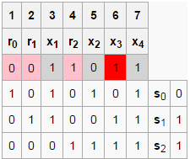
Decoding
s0 = (1*0+0*0+1*1+0*1+1*0+0*1+1*1) mod 2 = 2 mod 2 = 0
s1 = (0*0+1*0+1*1+0*1+0*0+1*1+1*1) mod 2 = 3 mod 2 = 1
s2 = (0*0+0*0+0*1+1*1+1*0+1*1+1*1) mod 2 = 3 mod 2 = 1
Syndrome matrix is (0,1,1)

Slide 36
Decoding
Syndrome matrix is a binary number of error position.
In example s = 011 and decimal representation of “110” is “6”, so error position = 6.

Slide 37
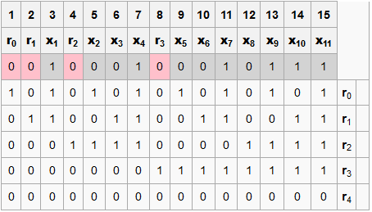
Example of general algorithm for Hamming (15,11)

Slide 38
References
Arndt C.
Information Measures: Information and its Description in Science and Engineering.
Thomas Cover. Elements Of Information Theory.

